Slide 1

Righting Reading in Grades 3-8
Joanne Coggins, PhD
Middle Tennessee State University
Righting Reading
Notes:
Opening
Poll the audience: Who are you?
Who I am.
I am Joanne Coggins, and my husband has severe dyslexia. I have seen the way it has impacted every aspect of his life. Many of our family members have dyslexia, and I have seen my students struggle to be “good at their job” at school while not being able to read well. For 17 years I taught high school English and Spanish, and Elementary ESL and SpEd. I started teaching with a deep commitment to improving the lives of children by helping them be successful in school. Very quickly I decided I needed many more skills and a lot more knowledge to be an effective teacher, so I earned a Masters in Secondary Education. Then I returned to school to earn my PhD in Literacy Studies with a specialization in the assessment and measurement of reading disabilities/dyslexia (As a psychometrician I am a skeptic. I need to see the results and dig through the data to see if this is the best thing I can do for my students). While I was teaching elementary special education, I was able to get $100k in training to effectively teach Lindamood-Bell Learning Systems’ Seeing Stars and Visualizing and Verbalizing reading programs. Using those programs, I was able to help my students with reading disabilities make meaningful reading skills gains. I have committed my life to helping fix the reading crisis in our country. Lives are at stake. I am on a mission to determine the best way we can get all children reading.
Students with reading disabilities are at a particular disadvantage in school and in life. A hundred years ago someone with low literacy might still be successful, but low literacy now increasingly leads to a life of poverty…or at least a poverty of opportunities. Successful adult workers need a high degree of literacy proficiency. To reach that goal, students need to be able to read and comprehend a variety of texts to build knowledge. Everyone needs to be able to read to continually educate themselves in our changing world.
In this study, students with reading disabilities in grades 3-8 made large reading fluency and reading comprehension gains using Readable English. This happened despite pandemic related school interruptions that led to widespread learning loss or stagnant learning in the control group. Students made significant gains in reading fluency skills. However, student reading comprehension grew phenomenally despite the short length of the study trial. The findings from this large experimental study offer hope for students with diagnosed reading disabilities and other populations such as multilingual learners and students with average and below average reading skills.
First, I want to show you how the reading program I researched is designed. You have not seen anything like this before, and I want you to be thinking about it and making predictions. Would this program work with my students? How well? In which areas? How are some of the ways it might be really useful? As I discuss the study design, program implementation details, and reveal the findings, consider the implications through the lens of your personal experience and expertise. I will leave time for a robust discussion, and I am counting on your feedback.

Slide 2
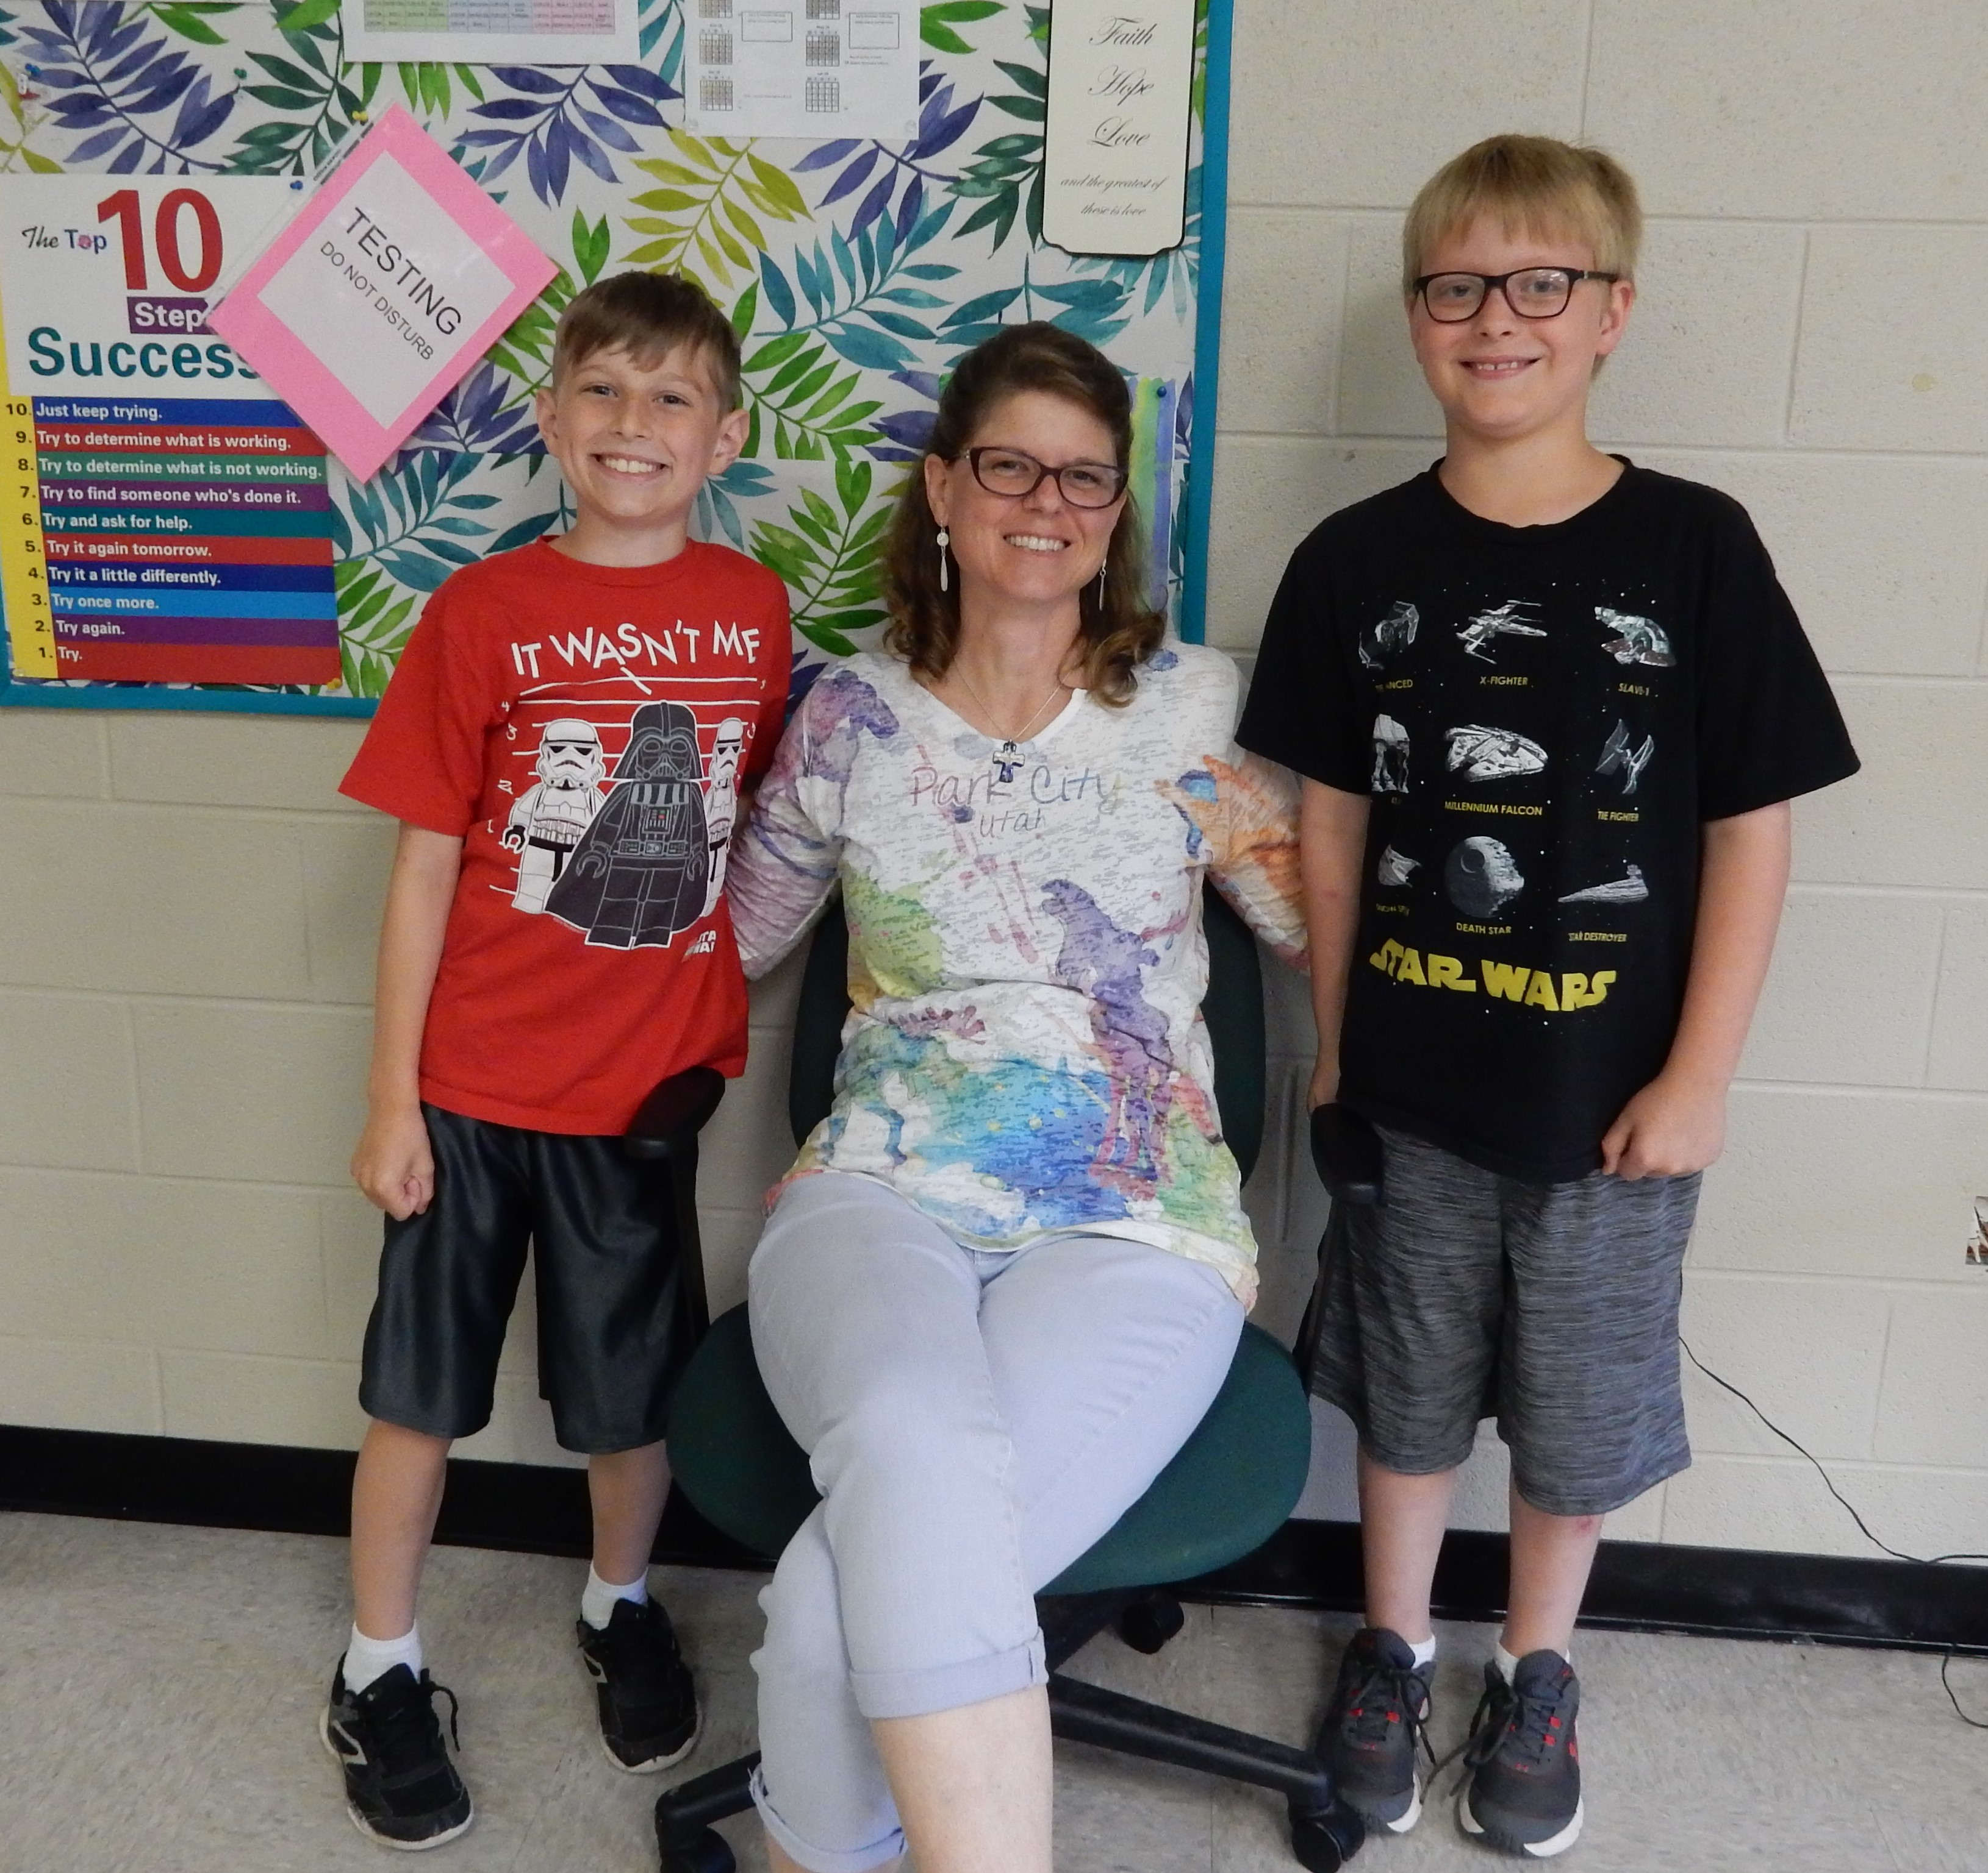
Pandemic Guinea Pigs
Notes:
Wanting to see if Readable English had the potential I thought I saw, I recruited my former 5th graders. Schools were closed and parents were willing to let me work with the kids online. (It was SO GREAT TO WORK WITH THEM!) Here are two of the dream team of 8 students I worked with from March through the summer of 2020. Carter and Beau (Their parents have signed a release so I can tell you this story.) both struggle with dyslexia, but they have great background knowledge and curiosity. I had worked with them through 4th grade and they made tremendous progress with reading fluency, but they had plateaued. Their working memory, and listening and reading comprehension were all very good. They made huge reading gains after 3 months of Readable English. Carter told me in July, “I was afraid to go to middle school, but now I know I am ready. I will be able to read anything we are doing in class as long as I can use the conversion tool.”
I’m a skeptic. These results seemed too good to be true. I’m going to do a study to see

Slide 3
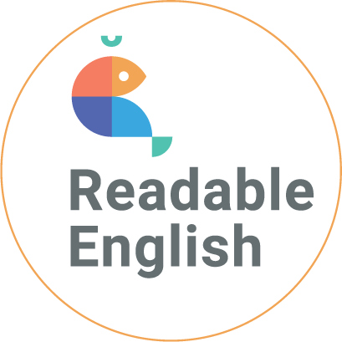
Structured Literacy Skills
phonemic awareness
phonics
spelling
syntax
semantics
writing
vocabulary
syllables
morphological awareness
comprehension
Notes:
Description of Program
Readable English includes all the structured literacy elements many other reading programs provide (including the reading program used in the control group).
Students work at the word level, then with connected text, then with increasingly complex text in various genres. The program benchmarks students on grade level to identify their reading levels, and then students are progress monitored at their instructional level.

Slide 4
The huge cognitive load of the English language
Students need to learn the 26 alphabet sounds and 12 digraphs
band
chest
expect
Students need to learn the
26 alphabet sounds, 12 digraphs and learn 45 rules
small
since
Only
280 words
are phonetic
350 words
follow a rule
1000
most common
words
Students must memorize 270 exceptions
flood
women
270 words
are exceptions
Notes:
English is hard and how RE makes it phonetic.
Elegant solution
Cognitive load
Training wheels for reading

Slide 5
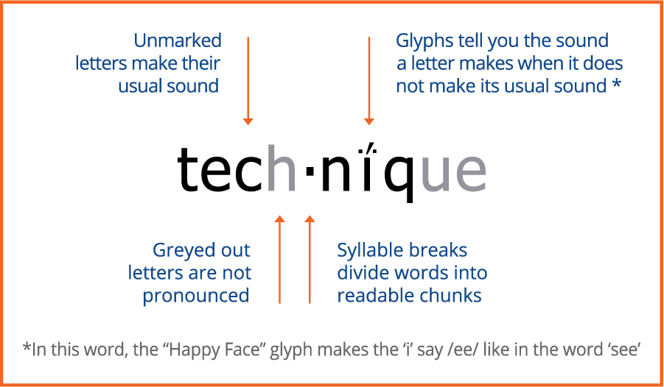
Notes:
Using a set of 21 glyphs (see Happy Face), every word in English becomes 100% phonetic. Letters that do not follow their primary or short sound have a glyph. Unspoken lett
Scripted with teaching guides and lesson plans
It is scripted, and teaching guides are included, which makes it very easy for teachers to use the program with fidelity. The instructional path and online tools are intuitive, making the program easy to implement. Teachers don’t spend any time making independent workstations or creating lesson plans. Students receive scaffolded support and spiral instruction. The student view tracks word reading volume and shows badges earned for educational milestones achieved. Many reading programs use structured literacy and are based on the science of reading, but this is where Readable English is completely unique…
English is hard and how RE makes it phonetic.
Elegant solution
Cognitive load
Training wheels for reading
ers are greyed out. And pronunciation breaks help chunk words into easily decodable pieces.

Slide 6
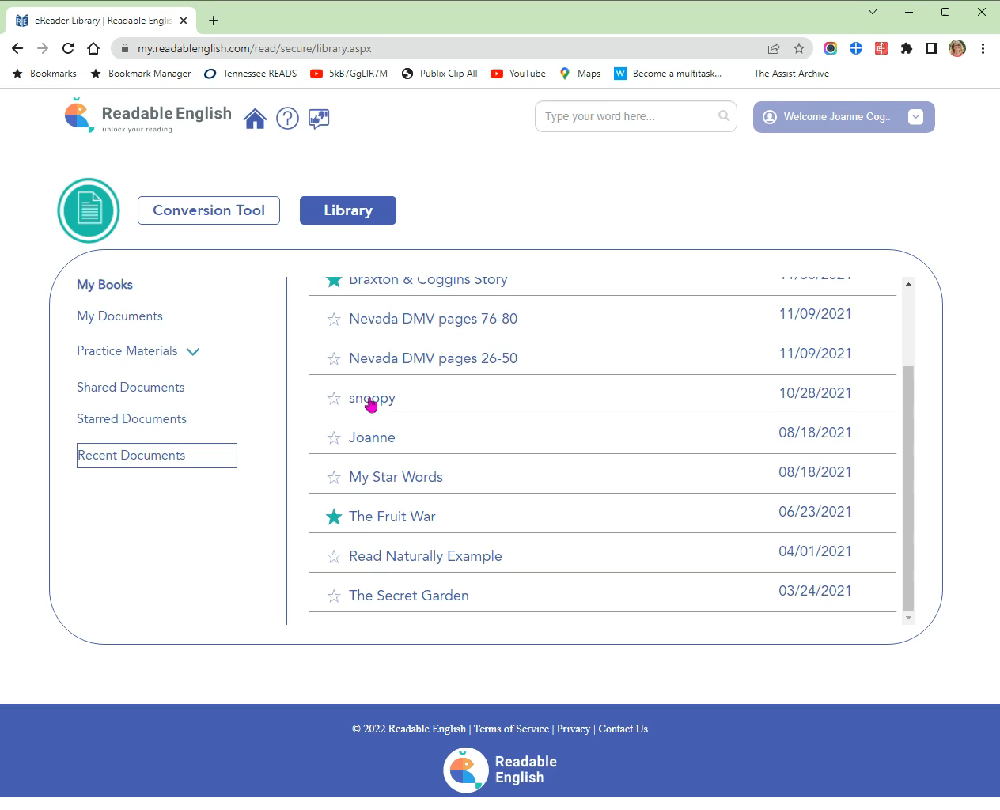
Notes:
The conversion tool is the secret sauce. Students can take control of their own learning. Year 1 vs. Years 2+ (up front investment in glyph learning, but after that it is just remediation and reading practice)
(I am narrating the action in this video of the conversion tool in action.)
Braxton’s story: 14-year-old “What’s this word?” habit “Oh, yeah, I can read any word now!”

Slide 7
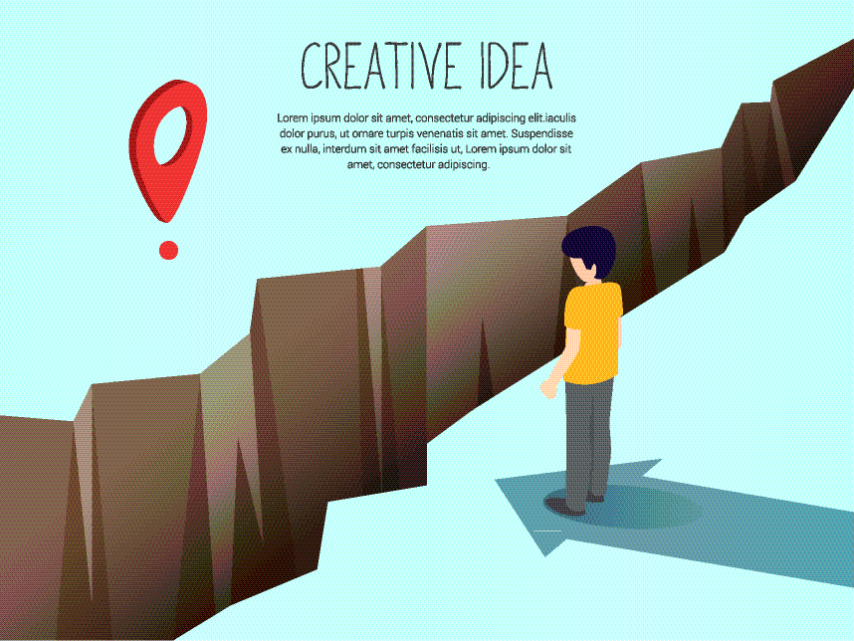
Pandemic
Action Research
SY 2020-21
Pandemic
Action Research
SY 2020-21
Pandemic Action Research SY 2020-21
Notes:
An Opportunity to Stop Learning Loss – and Measure the Results!
I was working with a school district in Indiana on general reading and Project-based Learning PD. That district and two neighboring districts were working with Readable English and had bought the coaching package to help with implementation. The districts agreed to let me measure their progress because they wanted the data!
3 school districts in Indiana– all rural participated in this large study. Indiana districts were phasing in implementation of Readable English at some schools and grade levels.

Slide 8









Data and Methods
Research Design
Participants
Recruitment
Instruction
Study Length
Assessments
Notes:
Participants
90% White, rural, low SES (52%-63% eligible for free/reduced-price lunch) (2 subgroups known to be at-risk for underperformance)
N = 236 (n Treatment = 136 + n Control = 100) identified with SLD-Reading/LI
Recruitment
Teachers recruited as either early or late adopters of phased-in program within districts. Elementary grades 3-5 recruited by grade levels. Middle School grades 6-8 recruited by teacher. Students randomly assigned to teachers.
Instruction
Control Groups “Business-as-usual” using either Amplify CKLA (elementary) or Amplify ELA (middle school) with additional reading projects assigned.
Treatment Groups Readable English only for 6 weeks (Phase 1), then RE with Amplify and novels in Readable English converted text.
Study Length
Mid-October to Late March/ Early April depending on pre- and posttesting schedules. About 11 weeks = 45-60 hours actual instruction after pandemic disruptions. Research plan included 85-100 instructional hours. (100-120 hours = 1 year reading growth.)
Assessments
EasyCBM CCSS Reading Comprehension and Passage Reading Fluency Benchmarks on grade level.
WRMT-3 Passage Comprehension and Oral Reading Fluency subtests standardized tests. GSV and grade equivalents (also looked at standard scores and percentiles to be sure they followed). These tests were given in standard English – NOT the Readable English mark-up. Transfer effects.
Analyses- One-Way ANOVA

Slide 9
EasyCBM Passage Reading Fluency Benchmarks
Effect Size Interpretations:
η²= .01 small/no effect
η²= .06 medium effect
η²= .14 large effect
Med
Effect Size
Readable English
F(1, 234) = 11.4 P<.001 η²= .05
Notes:
ANOVA
Delta WCPM P<.001 F(1, 234) = 11.4 η²= .05
Partial eta squared effect size interpretation:
η²= .01 small/no effect size
η²= .06 medium effect size
η²= .14 large effect size

Slide 10
EasyCBM Passage Reading Fluency Benchmarks
Med
Effect Size
Readable English
F(1, 234) = 14.6 P<.001 η²= .06
Notes:
ANOVA
Delta Accuracy P<.001 F(1, 234) = 14.6 eta²= .06 medium effect size

Slide 11
EasyCBM CCSS Reading Comprehension Benchmarks
Large Effect Size
Readable English
F(1, 234) = 40.8 P<.001 η²= .15
Notes:
ANOVA
CCSS Comp Raw P<.001 F(1, 234) = 40.8 eta²= .15 large effect size

Slide 12
Woodcock Reading Mastery Tests, 3rd ed.
Very Large Effect Size
Med
Effect Size
ORF F(1, 234) = 21.3 P<.001 η²= .08
PC F(1, 234) = 57.5 P<.001 η²= .20
Notes:
ANOVA
ORF P<.001 F(1, 234) = 21.3 eta²= .08 moderate effect size
PC P<.001 F(1, 234) = 57.5 eta²= .20 very large effect size

Slide 13
Woodcock Reading Mastery Tests, 3rd ed.
ORF F(1, 234) = 31.4 P<.001 η²= .12
PC F(1, 234) = 48.9 P<.001 η²= .17
Large Effect Size
Large Effect Size
Note: 10 months = 1.0 grade level
Notes:
ANOVA
ORF P<.001 F(1, 234) = 31.4 eta²= .12 large effect size
PC P<.001 F(1, 234) = 48.9 eta²= .17 large effect size

Slide 14

All Students Can Learn to Read
Notes:
Closing Statement:
These study findings indicate that Readable English offers a wealth of opportunity to children who need to learn to read well. Students in this study who used Readable English for half a school year gained 1.4 grade levels in reading comprehension. It will take such accelerated remediation gains to close the reading gaps these students have. I am excited about the ways Readable English can help teachers help students. Not only is Readable English effective, but it is also educationally sustainable. Teachers can implement it easily without having to spend hours figuring out a complicated new intervention. It is scripted, repetitive, and provides spiral instruction. It is based on the Science of Reading, and the conversion tool makes it possible for teachers to use their favorite texts and projects. Keeping those high interest projects and curricula means teachers can focus on how individual students are learning and growing.
The remediation exercises are designed to strengthen student reading skills by working discrete skills bidirectionally, just as you would lift weights to build muscles. The conversion tool makes English phonetically transparent which means students can read a greater volume of text more quickly, building their word recognition, vocabulary, and content knowledge. Because students can customize the conversion tool to their exact needs, it scaffolds student engagement with and access to text across the curriculum.
After initial remediation with Readable English, pull-out instruction for many students can be drastically reduced. This is because individualized scaffolding is built into the program’s text conversion tool to help students engage with grade level text across the curriculum. Additionally, this program might be used as an accelerated remediation tool to help get students back on track from pandemic learning loss or other instructional interruptions.
Limiting or eliminating the social stigma of pull-out remediation, while enabling students to meaningfully engage in general education classroom learning activities boosts student morale, motivation, self-confidence, and self-esteem. Students’ self-actualization is increased when they use the conversion tool to take control of their own learning.
The findings from this study are robust enough that this program merits further study. Though large, this is just a small taste of what could be possible.
Limitations
Rural, white, low SES – need studies with more diverse populations
Need replication studies
Need EL Pop study
Need better tools to track correlations between conversion tool use and word volume and student improvement. Where is the sweet spot?
Need qualitative survey information from students and teachers – What do THEY think?

Slide 15
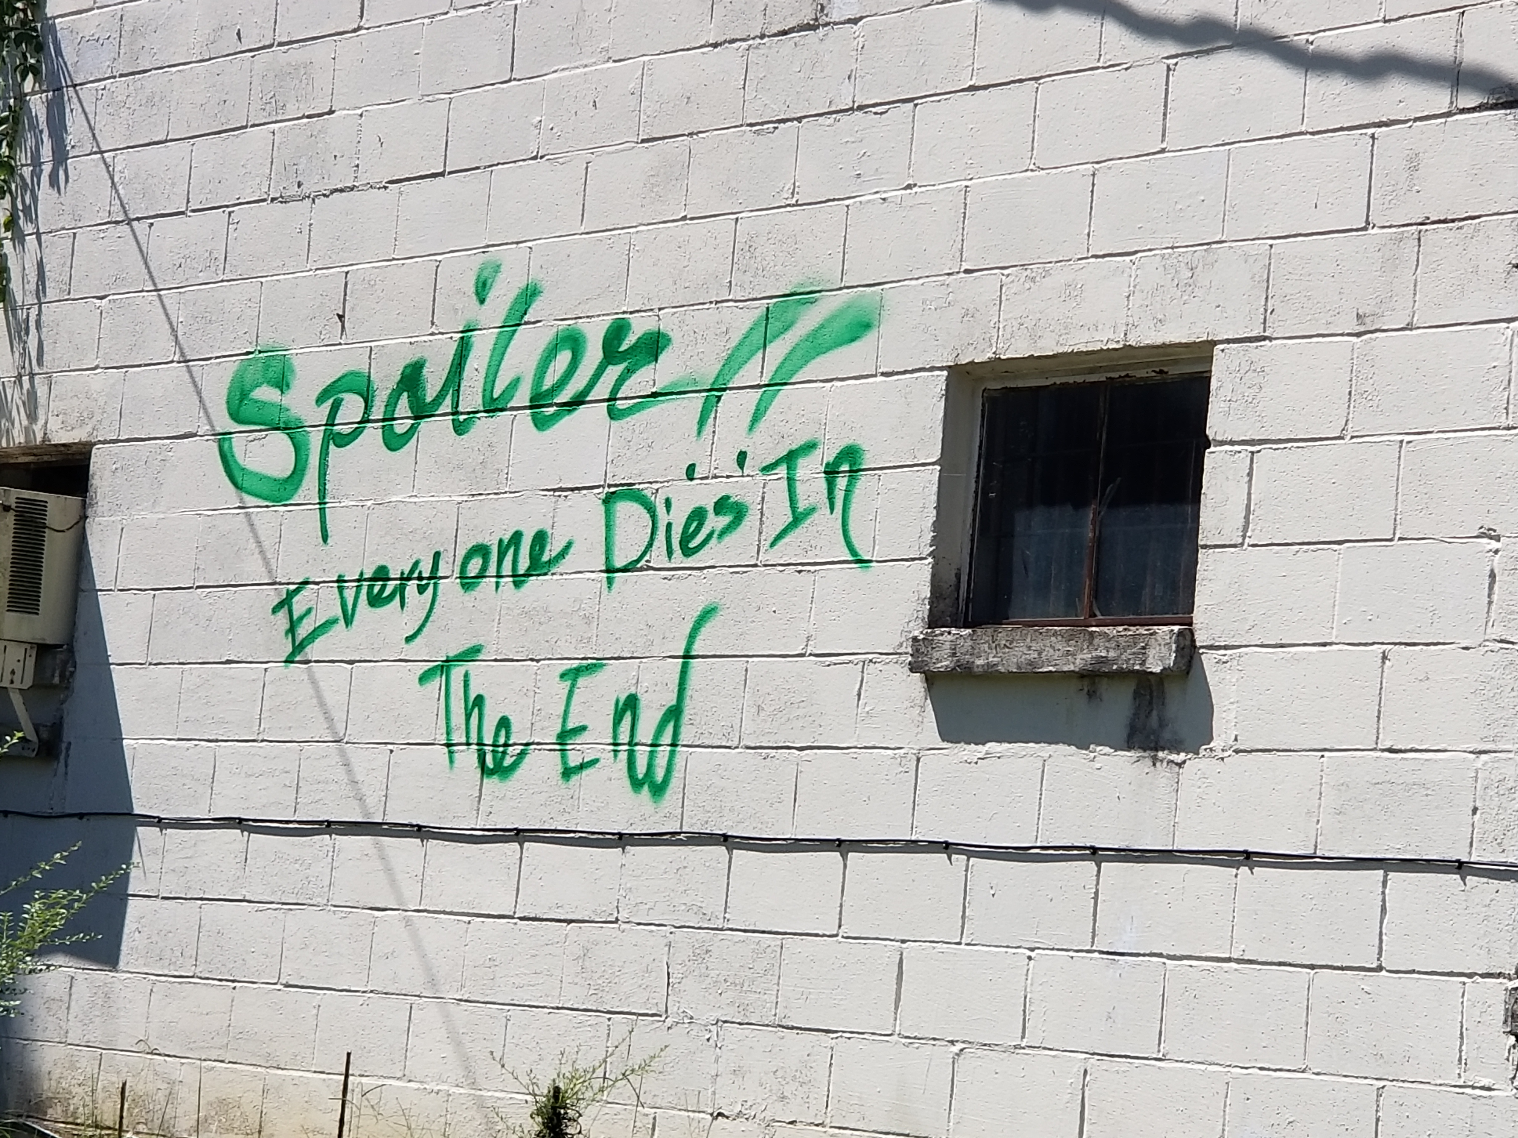
“We all hate reading.
Wanna see my book?”
Notes:
Middle School Story – “We all hate reading. Wanna see our book?”

Slide 16


Notes:
Audience Participation – What do you think? What are your thoughts? What obstacles or barriers do you see to using Readable English with your Students? How can you see your students best using Readable English?
What POSSIBILITIES do you see that I have not included here?
Key things I saw:
Faster Orthographic Mapping Process
Students can read any word in English.
Word Volume Increase
Student Confidence
Intact Spelling – MA
Less Pull-Out
Students able to “do their job”
More class participation
Maladaptive behaviors decrease
Less embarrassment
Assistive technology
Individual scaffolding
English Learners
Adult Learners
Leverage volunteers/other teachers to help teach using RE
Increased engagement (behavior changes before attitude)
When I first saw this graphic 3 years ago several thoughts flew through my head. 1) Orthographic mapping is going to be so much faster! Students will be able to pronounce any word once they know the system. 2) They will be able to read a greater volume of words to close their reading gaps. 3) The spelling is maintained! Morphological awareness will aid in figuring out what unknown words mean. 4) My dyslexic students will really benefit from this. 5) My older students will not need as much pull-out instruction AND they will be able to read grade level content in their classes! 6) Students will be able to participate in class projects and group work ACROSS THE CURRICULUM!!! 7) As their confidence improves, their maladaptive behaviors should subside. No more embarrassment factor. This becomes assistive technology.

Slide 17
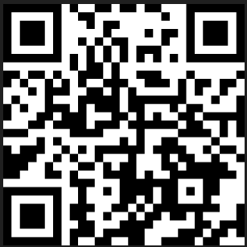
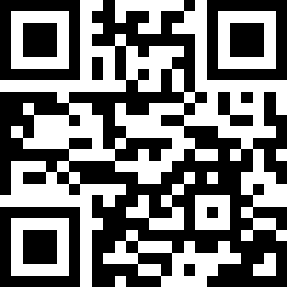
With Effective & Sustainable Instruction All Students Can Read
Call to Action
Use Readable English
Research Readable English
Presentation PDF RightingReading.com/Resources
Presentation Survey
Notes:
Help me do more of what works and less of what doesn’t. (Presentation Survey)
Presentation PDF at RightingReading.com

